Slide 1
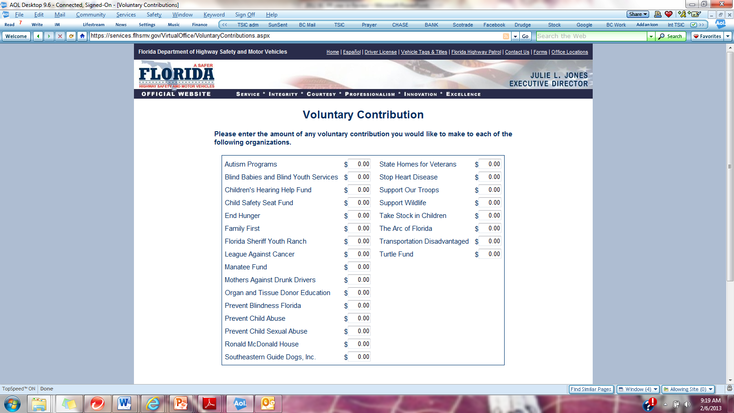
Play TAG
with Take Stock in Children
06-14
TSIC
RENEW YOUR TAG AND DONATE TO
TAKE STOCK IN CHILDREN
INVEST IN A COLLEGE SCHOLARSHIP FOR A DESERVING, LOW-INCOME STUDENT IN OUR COMMUNITY
For additional information, visit takestockinchildren.org or dmvflorida.org
Since 1995, Take Stock in Children has provided scholarships, mentors and hope to more than 22,000 deserving, low-income students in Florida. Take Stock in Children is a program operated by Brevard School Foundation.
For more information call 633-1000 Ext. 415 Contributions remain in the county of origin.

